Slide 1
PROJECT PRESENTATION ON AUTOMATIC TOLL COLLECTING SYSTEM(MTCS)
COURSE: STRUCTURE PROGRAMMING LANGUAGE LABORATORY
COURSE CODE: EEE 122(A)
STUDENT NAME: JOYANTA DEBNATH
STUDENT ID: 021-182-032

Slide 2
INTRODUCTION
Manual toll collection system (MTCS) is a system to collect the usage fee or toll charged to vehicles by least manual effort using toll roads, HOV lanes, toll bridges, and toll tunnels. A toll lane may operate alongside conventional toll booths so that drivers can pay at the booth. The following documentation is on a project which is about MTCS and its software implementation in toll booths that will clearly make manual efforts easier and hassle free as far digitalization is concerned. The key of the project is to design a user friendly, dynamic, responsive program to minimize manual efforts using C language.

Slide 3
DEVELOPMENT TOOLS
SOFTWARE REQUIREMENTS
CodeBlocks
Important library functions, Iterations of statement, Format specifiers
HARDWARE REQUIREMENTS
A computer
Operating System: Windows XP 16-bit
RAM : 1 GB
Storage : 120 GB

Slide 4
FEATURES
• Inexpensive
• Informative
• User friendly
• .exe file support
• Interactive

Slide 5
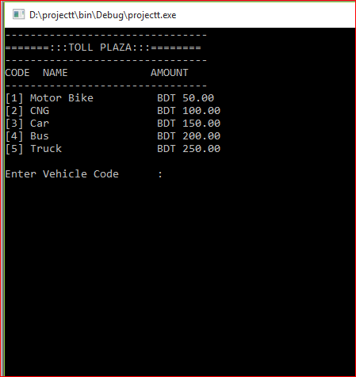
EXECUTING SUMMERY
This the Home-screen of the program. It required users command to recognize the vehicle.

Slide 6
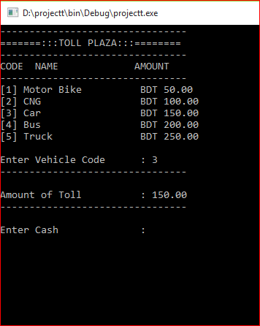
EXECUTING SUMMERY
Here the vehicle is recognized and the code automatically display the amount of to be paid

Slide 7
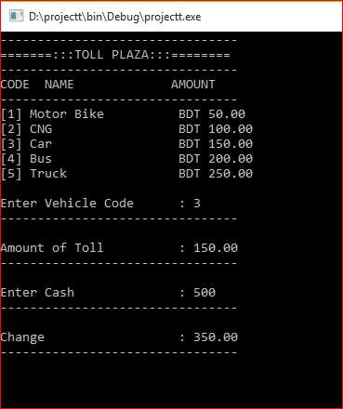
EXECUTING SUMMERY
User now receives payment from the registered vehicle and gives input to the program.

Slide 8
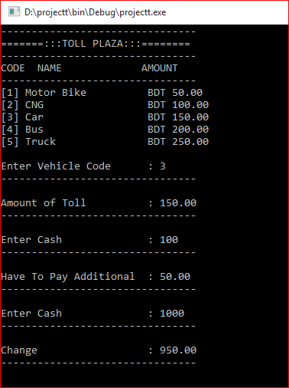
EXECUTING SUMMERY
Program will interact if there were any due payment. Thus user need to add further payment to keep the balance clear.

Slide 9
FUTURE SCOPE
• Improving security
• Add data store policy

Slide 10
SOFTWARE MAINTENANCE
Update data up-to date incase, information added or removed.
Giving security check-up to a consecutive basis

Slide 11


